Slide 1

Last-Mile Delivery Operations Analytics

Slide 2
Meet Team
V.Harshitha
P.Meghana
G.Harshitha Reddy
Background: B.Tech
Background: B.Tech
Background: B.Tech
Experience: Fresher
Experience: Fresher
Experience: Fresher
LinkedIn:
https://www.linkedin.com/in/harshitha-veeramaneni-08874228b/
LinkedIn:
www.linkedin.com/in/meghana-paruchuri-00a220313
LinkedIn:
https://www.linkedin.com/in/harshitha-reddy-579b6831a/
GitHub:
https://github.com/harshitha1119
GitHub:
github.com/paruchurimeghana
GitHub:
https://github.com/harshitha-reddy206

Slide 3
Table of contents
Project Overview
Business Scenario
Business Objectives
Dataset & Database Overview
ER Diagram & Database Structure
Analysis of the Objectives
Overall Key Findings
Business Recommendations
Conclusion
Q&A

Slide 4
Project Overview
Last-mile delivery is the final stage of delivering an order to the customer.
Efficient delivery operations depend on demand, delivery status, drivers and available vehicles.
This project uses SQL to analyze operational data stored across multiple tables.
The analysis focuses on identifying patterns, performance gaps and resource utilization.
The final insights help improve delivery planning and operational decision-making.

Slide 5
Business Scenario
Quick Route Logistics handles deliveries across different zones and service categories.
As the number of orders increases, the operations team needs a better understanding of delivery demand and operational performance.
Managing increasing order volumes across different delivery zones.
Understanding which service types and priority levels create the highest demand.
Monitoring delivery outcomes such as Delivered, Pending, Failed, and Rescheduled.
Drivers
↘ ↗
Customers
→
Orders
→
Deliveries
Vehicles
3

Slide 6
Business Objectives
1
Analyze Delivery Demand
dentify high-volume zones, service types and priority categories.
2
Understand Customer Behaviour
Find repeat customers and analyze customer order value..
3
Measure Delivery Performance
Evaluate successful, failed, pending and rescheduled deliveries.
4
Evaluate Resource Utilization
Analyze driver workload and vehicle usage.
5
Detect Operational Issues
Identify repeated delivery attempts and zones with higher delivery problems

Slide 7
Dataset & Database Overview
Observation
3,500 deliveries are recorded for 3,000 orders, so some orders have more than one delivery record.
Table | Description | Records
Customers | Customer information and category | 400
Orders | Order details, value, service and priority | 3,000
Deliveries | Delivery status, duration and attempts | 3,500
Drivers | Driver information and availability | 80
Vehicles | Vehicle details and capacity | 50
Finding
The five tables are connected through IDs (keys).
5

Slide 8
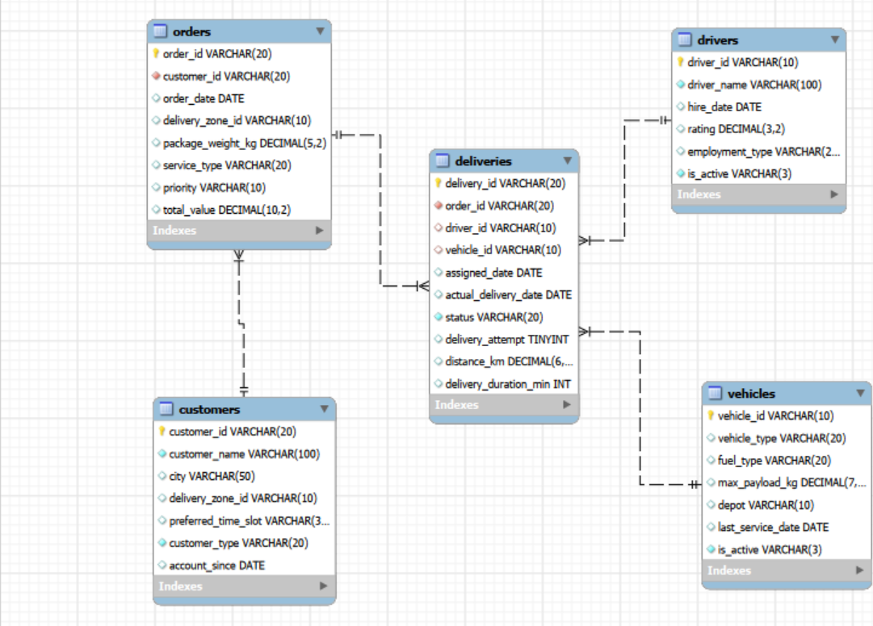
ER Diagram & Database Structure
Main Relationships
• Customers → Orders
• Orders → Deliveries
• Drivers → Deliveries
• Vehicles → Deliveries
Primary Keys
• customer_id, order_id
• delivery_id, driver_id, vehicle_id

Slide 9

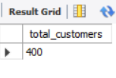




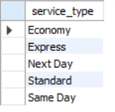


Basic Analysis: SQL Check
Key Findings:
400 customers and 3,000 orders
3,500 delivery records
5 service types available
75 active drivers
Key Insights:
High repeat customer activity
Delivery volume exceeds order volume
Multiple service options support varied customer needs
Driver capacity is crucial for operations

Slide 10
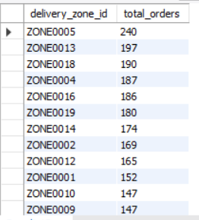
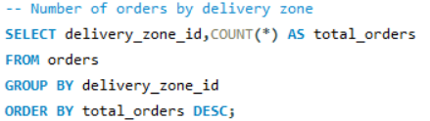
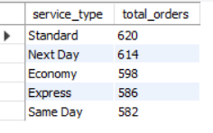
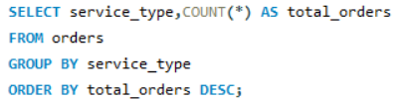


Analysis of the Objectives: Delivery demand
Orders By Zone:
Key Findings:
ZONE0005 generated the highest demand — 240 orders
Standard service recorded the highest volume — 620 orders
High-priority orders led demand — 1,035 orders
Orders by Service Type:
Key Insights:
Demand is concentrated in specific zones, while Standard service and High priority dominate order volume.
Orders by Priority:

Slide 11
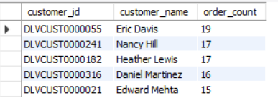
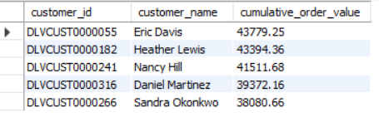
Customer Order Behaviour
Top Customers by Orders:
SELECT
c.customer_id,
c.customer_name,
COUNT(o.order_id) AS order_count
FROM customers c
JOIN orders o
ON c.customer_id = o.customer_id
GROUP BY
c.customer_id,
c.customer_name
ORDER BY order_count DESC;
Top Customers by Order Value:
SELECT
c.customer_id,
c.customer_name,
ROUND(SUM(o.total_value), 2)
AS cumulative_order_value
FROM customers c
JOIN orders o
ON c.customer_id = o.customer_id
GROUP BY
c.customer_id,
c.customer_name
ORDER BY cumulative_order_value DESC;

Slide 12
Delivery Performance
The delivery data was analyzed to measure operational success and identify areas requiring improvement.
Performance Summary
Total delivery records analyzed: 3,500 .
Successfully delivered: 73.7%.
Pending, failed or rescheduled: 26.3% .
Average delivery duration: 47.2 minutes.
ZONE0020 recorded the highest reported delivery problem rate.
Key Insight
Although most deliveries are completed successfully, unresolved deliveries create
workload and may affect customer satisfaction.

Slide 13
Driver & Vehicle Performance
DRIVER WORKLOAD
DRIVER SUCCESS
VEHICLE USAGE
VEHICLE SUCCESS
68
86.5%
717
75.0%
DRV00073
DRV00027*
Cargo Bike
Electric Van
KEY FINDINGS
KEY INSIGHT
• Driver workload varies across the fleet. • The busiest driver is not necessarily the best performer. • Vehicle type affects usage and outcomes.
Resource allocation should consider delivery
workload, success rate and delivery duration, rather than assigning resources based on volume alone.

Slide 14
Delivery Problems
Operational Problems
165 delivery records required more than one attempt — approximately 4.71% of delivery records.
Problem Areas
Failed deliveries, Pending deliveries, Rescheduled deliveries, Multiple delivery attempts.
Zone Findings
ZONE0019 has the highest multiple-attempt rate; ZONE0020 also shows relatively high repeated-attempt activity.
Key Insight
Reducing repeated delivery attempts can reduce operational effort and improve delivery efficiency. Package weight does not show a strong relationship with delivery duration.

Slide 15
Overall Key Findings
DEMAND
ZONE0005 has the highest demand (240 orders).
GROWTH
Order demand increased from 608 in 2022 to 1,229 in 2024.
CUSTOMERS
Individual customers generate the most demand; Eric Davis has 19 orders.
DELIVERY
2,581 of 3,500 delivery records were delivered; ZONE0020 is weakest.
RESOURCES
75 of 80 drivers are active; Cargo Bikes and Trucks handle high volume.
PROBLEMS
165 deliveries (4.71%) needed multiple attempts; ZONE0019 is highest.
20

Slide 16
Business Recommendations
Increase operational capacity in high-demand delivery zones.
Investigate the reasons behind delivery problems in ZONE0020.
Monitor failed and pending deliveries regularly using SQL-based KPIs.
Improve customer coordination to reduce repeated delivery attempts.
Balance driver assignments according to workload and performance.
Select vehicles based on route requirements and delivery demand.
Track repeat customers and use their behaviour to improve service planning.
Use historical order trends to support future capacity decisions.

Slide 17
Conclusion
The Last-Mile Delivery Operations Analytics project demonstrates how SQL can be used to analyze large volumes of logistics data and generate meaningful operational insights.
By examining customer activity, order demand, delivery outcomes, driver workload and vehicle utilization, the project identifies important patterns and operational challenges.
The analysis provides a data-driven approach for improving:
Delivery efficiency
Resource allocation
Capacity planning
Operational monitoring
Customer service
Overall, SQL analytics helps transform delivery data into actionable information for better business decisions.

Slide 18
Q&A
Questions & Discussion

Slide 19

THANK YOU

